Slide 1


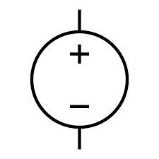
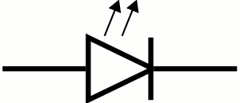

UART
TO
PC
TB6560 DRIVER
LV1
+3.3V
HV1
+5V
GND
CLK+
DIR+
+24V
GND
A
Ā
B
Ḇ
LEVEL SHIFTER
+12V
GND
TM4C123GXL
ROT. ENCODER
UART1 CTS (PF1)
UART1 RTS (PC4)
UART1 RX (PB0)
UART1 TX (PB1)
QEI0 PhaA (PD6)
QEI0 PhaB (PD7)
QEI1 PhaA (PC5)
QEI1 PhaB (PC6)
PWM0 (PB6) GPIO0 (PE1)
GPIO1 (PD1)
GPIO2 (PD2)
GPIO3 (PD3)
+5V
+3.3V
GND
PhaA
PhaB
+5V
GND
24V
FLEXMOD P3
LDA+
LDK-
INT
MOD+
GND
+12V
ROT. ENCODER
PhaA
PhaB
+5V
GND
2A
12V
TB6560 DRIVER
2W M140 445 NM
CLK+
DIR+
+24V
GND
A
Ā
B
Ḇ

